Slide 1


[Title]

Slide 2


Today's agenda
Project recap
Problem
The Analytics team
Process
Insights
Summary

Slide 3

Social Buzz is a fast growing technology unicorn that need to adapt quickly to it’s global scale. Accenture has begun a 3 month POC focusing on these tasks:
An audit of Social Buzz’s big data practice
Recommendations for a successful IPO
Analysis to find Social Buzz’s top 5 most popular categories of content
Project Recap

Slide 4

Problem
Over 100 000 posts per day
36 500 00 pieces of content per year!
But how to capitalize on it when there is so much?
Analysis to find Social Buzz’s top 5 most popular categories of content

Slide 5



Zhibek Abdyramanova
Data Analyst
The Analytics team
Marcus Rompton
Senior Principle
Andrew Fleming
Chief Technical Architect

Slide 6
Process
1
Data understanding
2
Data cleaning
3
Data modelling
4
Data analysis
5
Uncover insights

Slide 7

Insights
16 unique categories
Most popular category is animal
The top-3 reactions on animals are scared, peeking, hate!
May, 2021 is the most active month is terms of posts: 2138 posts!
January, 2021 second
August 20202 third

Slide 8
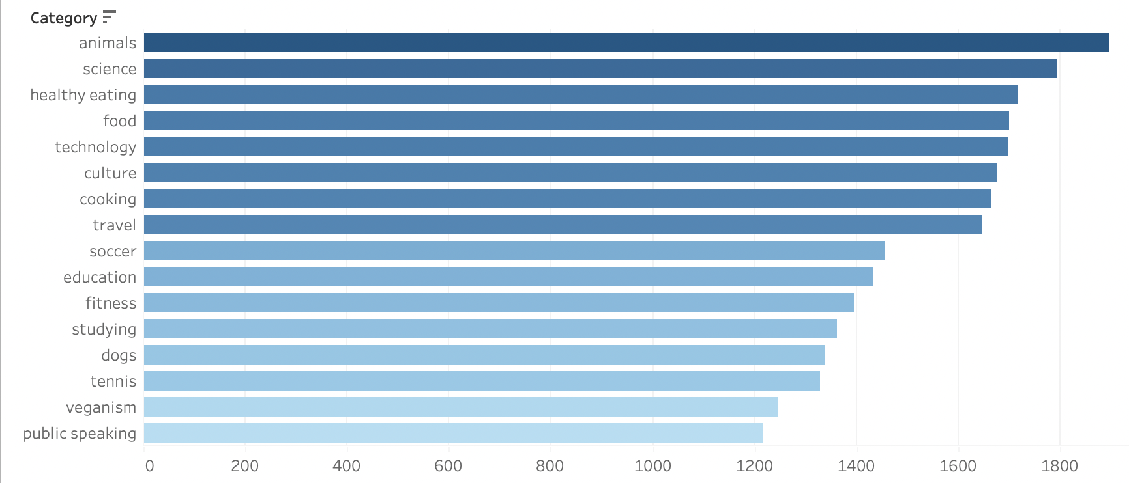

Slide 9
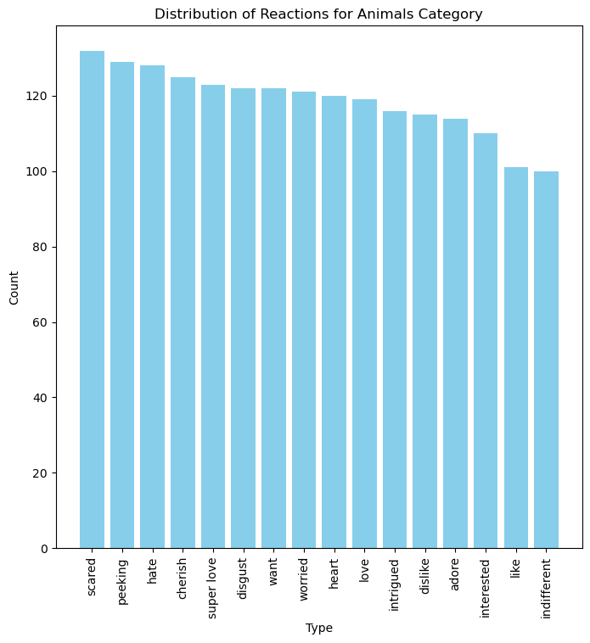
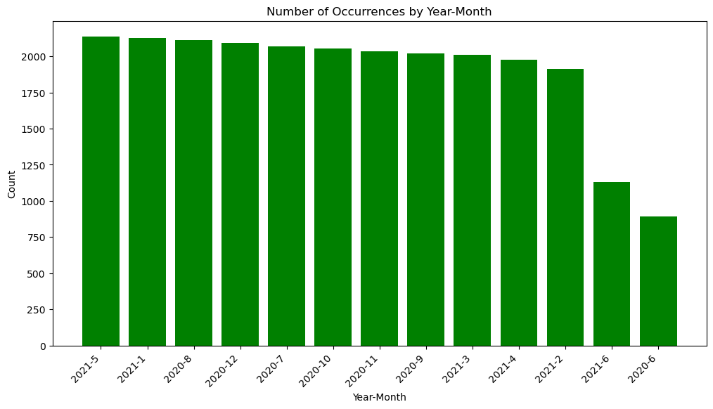

Slide 10

Summary

Slide 11

Thank you!
ANY QUESTIONS?

